Slide 1

Alteryx Datathon – Goldman Sachs
Team 6:
Aadithya Vidyasagar
Bhavana Sai Landu
Pranav Jain
Prasuna Sai Rikkala

Slide 2

Business Case
Gaining insight into the impact of the COVID pandemic on the finance, food, and gas industries and its potential effect on stock markets.

Slide 3
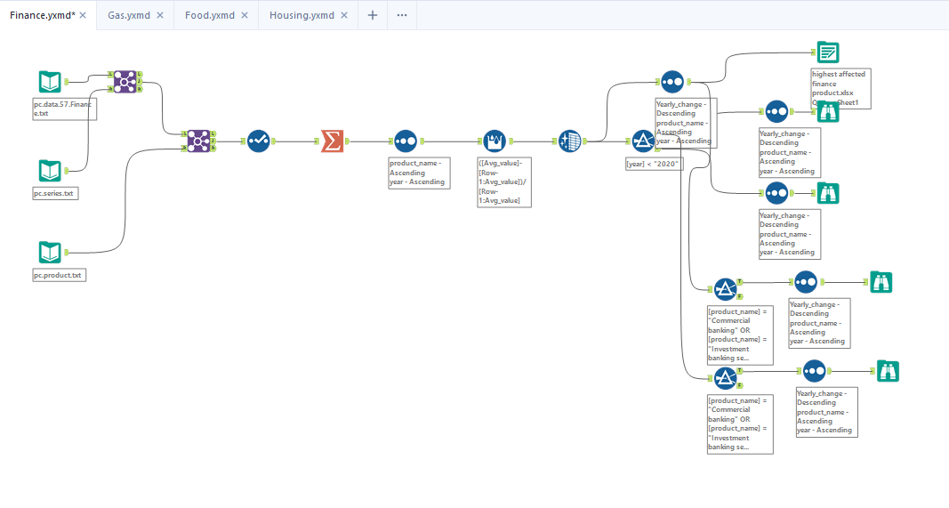
Finance Industry

Slide 4
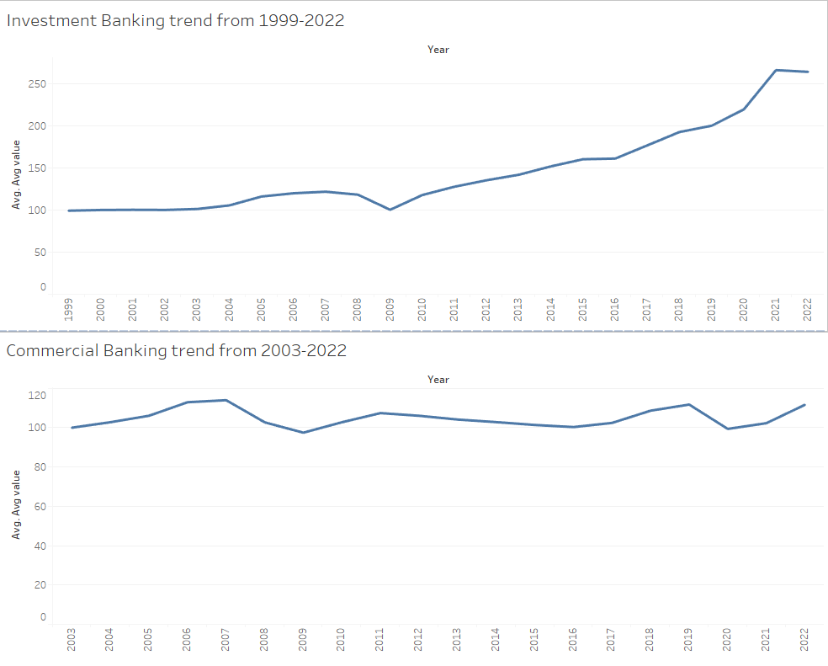
Finance Industry

Slide 5
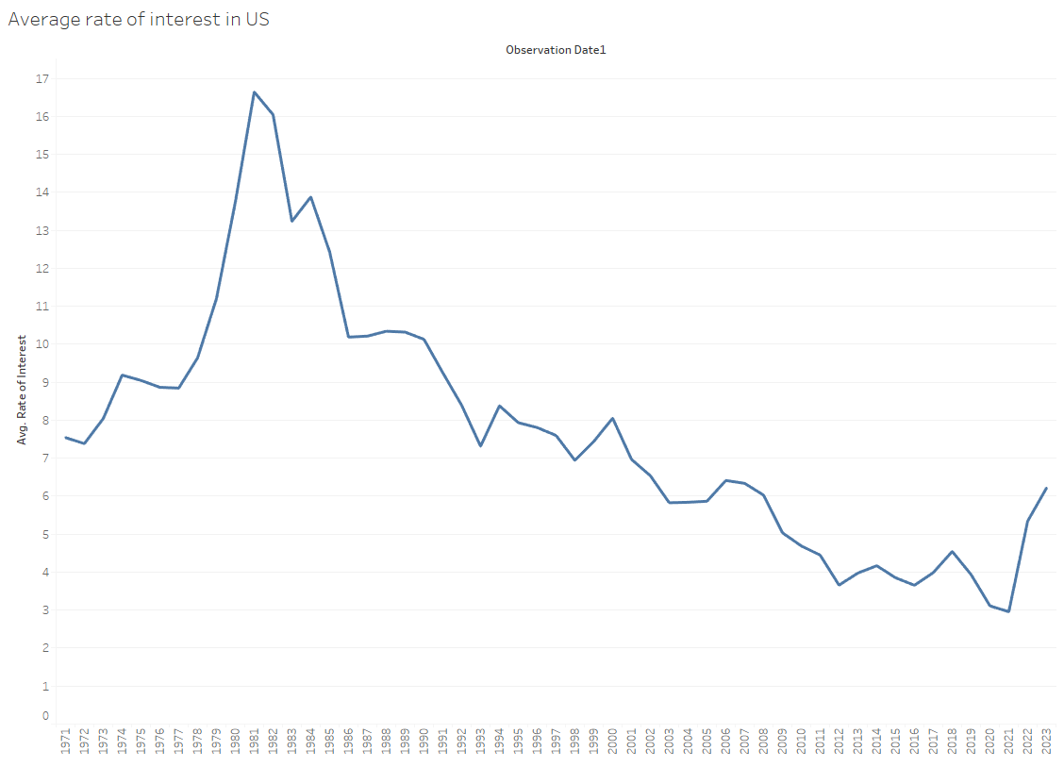
Interest Rates in US from 1971-2023

Slide 6
Insights
Changes in interest rates can have a significant impact on the stock market for finance industries. Higher interest rates can make it more expensive for individuals and businesses to borrow money, which can reduce demand for loans and lead to decreased earnings for financial institutions.
Conversely, lower interest rates can increase demand for loans and boost earnings for financial institutions, potentially leading to an increase in their stock price.
Interest rates impact stock market and financial industry by affecting companies' borrowing costs, consumer spending and borrowing, and the bond market.
Investor sentiment influences finance company stock prices, with optimism driving investment and stock price growth and pessimism leading to decreased investment and lower stock prices.

Slide 7

Gas Industry

Slide 8
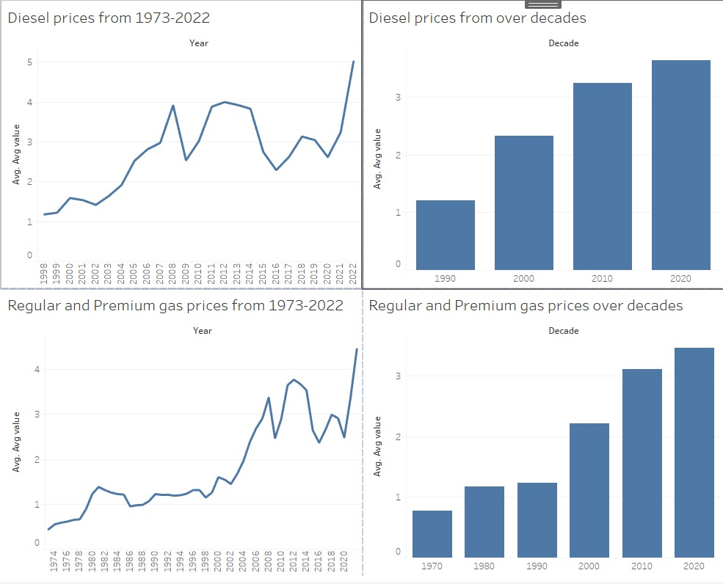
Gas Industry

Slide 9
Insights
Effects Of Rising Gas Prices on
economy as a whole
consumer
companies
stock market indices

Slide 10

Food Industry

Slide 11
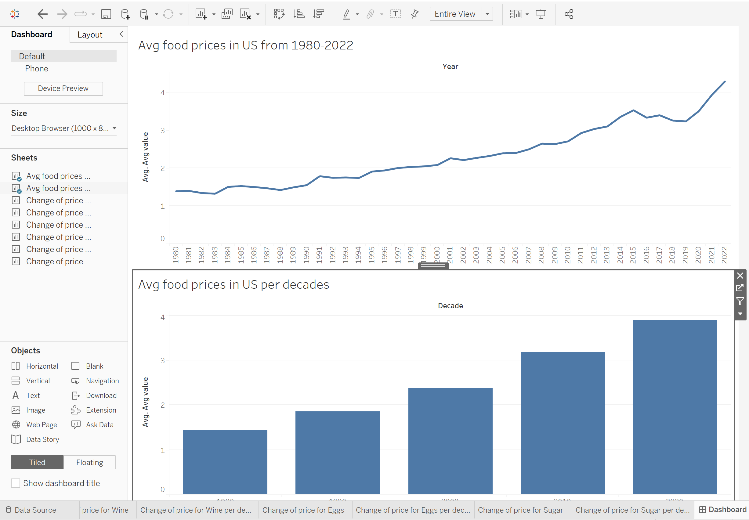
Food Industry

Slide 12
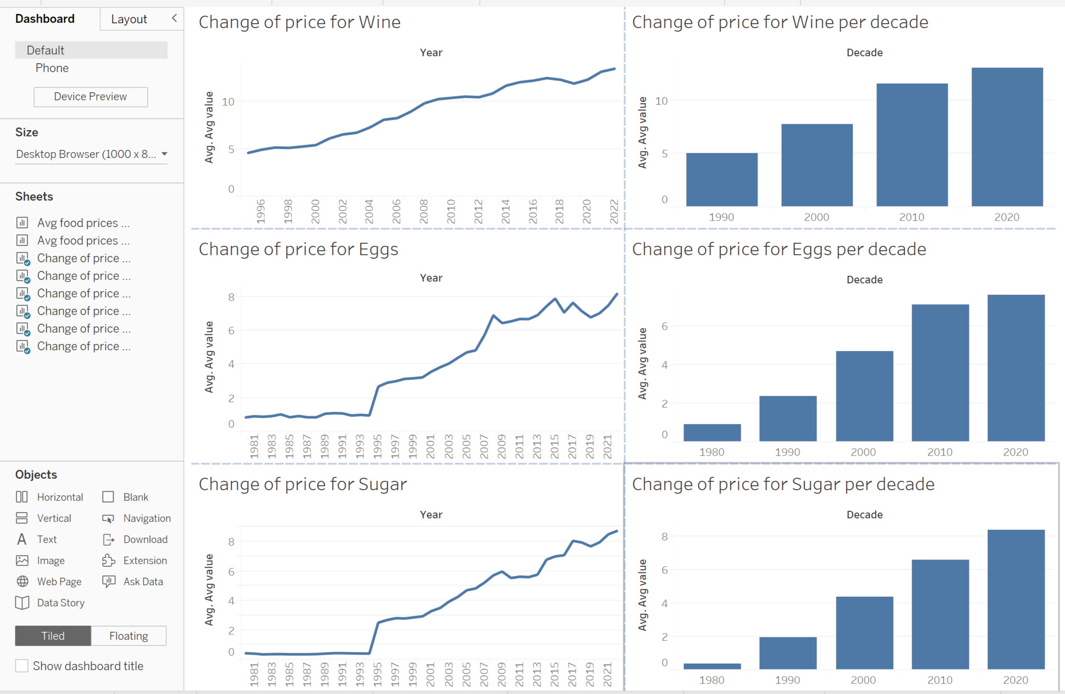
Change of prices for three different kinds of foods

Slide 13

Insights
Wine Industry showed highest increase in prices on year-on-year basis, followed by eggs and then sugar.
It is evident that, higher food prices can lead to increased earnings for food companies. However, high food prices can also result in reduced consumer spending, causing a decline in economic activity and a drop in stock prices. Conversely, lower food prices may drive up consumer spending and the economy, lifting stock prices.
Companies that can effectively manage their costs and pass on price increases to consumers are more likely to maintain their market share and profitability, which can support their stock price.
In Conclusion, changes in food prices can have a significant impact on the stock market for food industries, affecting a company’s revenues, consumer spending and competition.

Slide 14
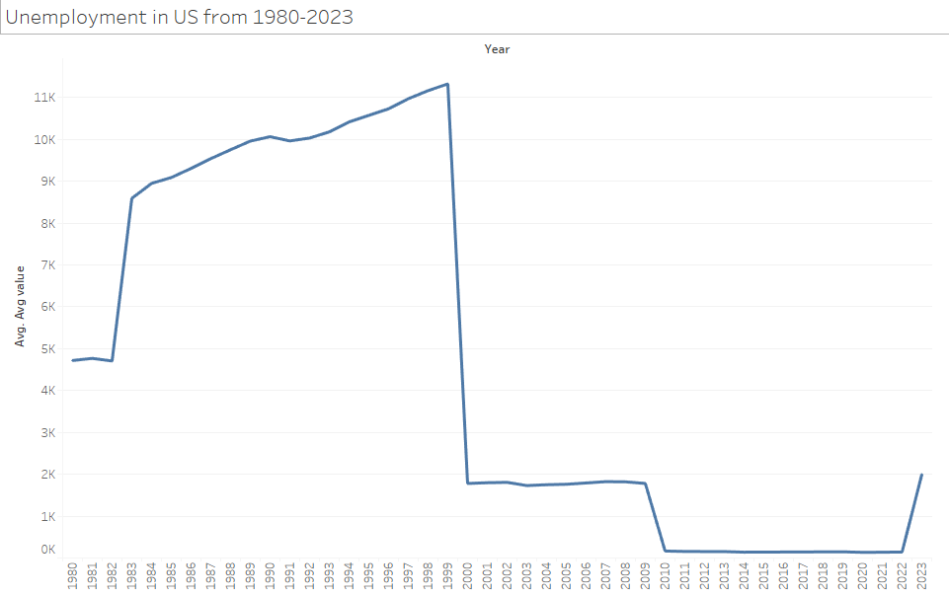
Unemployment trend in US from 1980

Slide 15
Interest Rates in US from 1971-2023

Slide 16
Insights
Unemployment affects stock prices by indicating economic health. High unemployment leads to lower consumer spending and corporate profits, causing a drop in investor confidence and stock prices.
Low unemployment, on the other hand, boosts consumer spending and corporate profits, resulting in higher investor confidence and stock prices. However, it's one of many factors that impact stock prices.
Other factors, such as interest rates, inflation, and global events, can also have a significant impact on the stock market.

Slide 17
Conclusion
The COVID-19 pandemic has had a profound impact on the global economy, including the finance, food, and gas industries. The finance industry has seen a significant shift towards digital banking and trading as a result of lockdowns and social distancing measures, leading to an increase in online transactions and a decline in traditional brick and mortar banking.
The food industry has experienced significant disruptions in supply chains and a rise in demand for grocery delivery services, leading to an increase in competition and the need for companies to adopt new technologies to stay competitive. The gas industry has also been affected by the pandemic, with decreased demand for fuel due to lockdowns and travel restrictions, leading to a decline in oil prices and a shift towards alternative energy sources.
The impact of these changes on the stock markets has been mixed, with some companies experiencing significant declines in stock prices while others have seen significant gains. Companies that have been able to adapt to the new market conditions and capitalize on new opportunities have generally performed well, while companies that have been slow to respond have struggled.
In conclusion, the COVID-19 pandemic has had a significant impact on the finance, food, and gas industries, leading to changes in consumer behavior, market dynamics, and technological advancements. The impact on the stock markets has been diverse, with some companies performing well while others have struggled. As the pandemic continues to evolve, it is likely that the financial, food, and gas industries will continue to face new challenges and opportunities.

